Slide 1

Presentation Of Data Analytics
PRESENT BY: MANAN KADIA
GUIDANCE BY: MANVI MAM

Slide 2
Tell me about yourself
Hello, My Name is Manan Kadia I am a data analyst. I have completed my master in master of science in organic chemistry from Gujrat university. Also I am pursing certification in data analyst from tops technology. I am from Gandhinagar and we have three member in my family. I have 3.5 years experience in pharmaceutical industry. I like watching movie in theaters with good friends. My favourite festival is Diwali. My hobbies is learn new things, watching movies. Thank you.

Slide 3
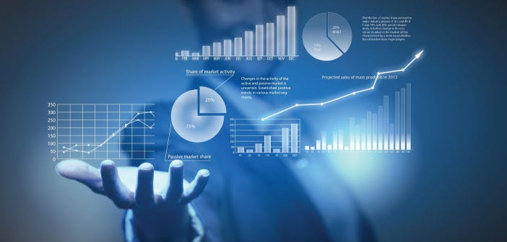
Introdution to Data Analytics
Data analytics harnesses the power of data to uncover valuable insights, driving business growth and enhancing organizational strategies. By analyzing vast datasets, it illuminates trends and patterns that inform critical decisions. Through visualization techniques, complex information is transformed into clear, actionable visuals, empowering businesses to optimize processes and seize opportunities for innovation and efficiency.

Slide 4
Technical skills
SQL(Structured Quey Language)
Programming Launguages
Python
Data Management & Data Visulization Skills
Data Cleaning and Preparation
Data Analysis
Power Bi
Excel
Statistics

Slide 5
Soft Skills
Good Communication
Positive Attitude
Self Motivation
Teamwork
Confidence

Slide 6
Strength Weakness
Achivement
Learning language
Good understanding
Time management
Emotional
Shopping

Slide 7

Presentation of HR question
1. HR Question
Personal Details
Goals , Skills
Future
Talk about short term goal
Talk about long term goal

Slide 8
Short term goals
Understand Data Sources and Collection Methods
Data Cleaning and Preparation
Become Proficient in Data Visualization
Exploratory Data Analysis
Projects
Feedback and Continuous Improvement

Slide 9
Long term goals
Subject Matter Expert
Learn Analytics Projects
Contribute to Industry Leadership
Mentor and Train Junior Analysts
Decision Making

Slide 10

Technical question
Why this course
I came to the realization that I couldn't genuinely appreciate my profession as a production officer. I've always been interested in learning new things, and I especially liked learning new skills. A friend of mine helped me out when I was thinking about changing careers by giving me thorough information about a certain field, which caught my attention because I've always enjoyed technology.

Slide 11
Thankyou

